Slide 1
The 7 Feasts of Israel The Fall Feasts Leviticus 23

Slide 2
Seven Feasts of Israel--Review
Passover
Unleavened Bread
Spring
Firstfruits
Shavuot
Teruah-Trumpets
Day of Atonement
Fall
Tabernacles

Slide 3
Seven Feasts of Israel
Passover
Unleavened Bread
Fullfilled
Firstfruits
Shavuot
Teruah-Trumpets
Day of Atonement
Future
Tabernacles

Slide 4
Giving of the Law
Giving of the Spirit

Slide 5
Shavuot/Pentecost
Came 50 days after Firstfruits
Offerings
7 young male rams—Kebes=young, less or no more than 1 year
1 young bull—Par=yearling bull as opposed to mature bull
2 mature rams—Ayil=fully mature rams
2 loaves of bread—Chamets=made with leaven

Slide 6
Shavuot/Pentecost
7 young male rams
1 young bull
2 mature rams
1 male goat
2 additional male lambs
Offered with the Bread Offering
‘Olah type offering
Hata’at type offering
Shelamim by Tenufah

Slide 7
Shavuot/Pentecost
Procedure:
Bread presented at foot of the altar
Nothing with leaven could approach the altar
This wave offering took place back/away from steps
Why the leaven?
Believers with sinful natures or “Israel” and Judah together
=One new man…Ephesians 2:14

Slide 8
Shavuot/Pentecost
NOTE: Animal offerings in the first four feasts
were Male.
Passover—Yeshua’s Death
Unleavened Bread—Yeshua’s Burial
Firstfruits—Yeshua’s Resurrection
Pentecost—Giving of Holy Spirit
Yeshua was male…the perfect Male Sacrifice
Firstfruits were sanctified, then people could partake
His resurrection first, accepted, so we can participate now

Slide 10
Teruah/Trumpets—Beginning of Fall Feasts
7th month (Tishri) begins civil year
1st day 7th month = Rosh Hashanna
Noted for trumpet blasts
Designated as a Sabbath
Now we have 3 Sabbaths to define

Slide 11
Trumpets—Beginning of the Fall Feasts
The Sabbath = every seventh day
A Sabbath = Attached to Feast
--Do not fall on a specific day (7th)
--Do not require all work to cease
--these are preparation days
New Year’s Sabbath is like The Sabbath But…
--Does not fall on specific day
--All work ceases
--But Sacrifices brought to Temple

Slide 12
Trumpets—Beginning of the Fall Feasts
Where are we now?
After Pentecost
Before Trumpets
Spring Feasts fulfilled
Fall Feasts are FUTURE

Slide 13
Trumpets—Beginning of the Fall Feasts
When “our” trumpets sound a call
To War—The last war
To Assemble as God’s Holy Convocation
According to Pattern: Possible Return Messiah

Slide 14
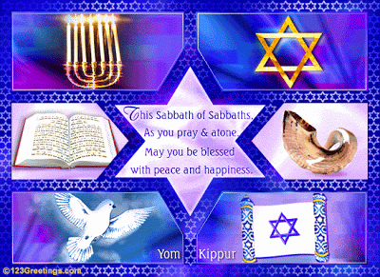
Yom Kippur
Day
Of
Atonement

Slide 15
Yom Kippur—the Fall Feasts
9 days later (after Trumpets)
10th day 7th month cam Yom Kippur
These inclusive 10 days = High Holy Days
1st of Tishri, Rosh Hashana called: Feast of Trumpets
Trumpets called to: Assembly or to War

Slide 16
Yom Kippur
Most kept day of all the days
Spent in synagogue
Fasting
Self Denial
No work
No leather (orthodox)
Talmud
Bathing
Cosmetics
sex

Slide 17
Yom Kippur –General
Two pronged meaning to the day
First, purity of the sanctuary
Concept: Holy cannot dwell where impurity is; Holy and profane don’t mix
Concept: constant sin offerings somehow defiled the sanctuary
Concept: Cleansing from contact with unholy required cleansing
Concept: Sanctuary represents God’s presence, is also human sanctuary, subject to imperfections

Slide 18
Yom Kippur –General
Two pronged meaning to the day
Second, atonement for sins of Children of Israel
Note: This Day of Atonement addressed to all people
Note: Once Tabernacle is cleansed (by blood) then the people can be cleansed
Note: Verse 16:30

Slide 19
Yom Kippur…Day of Atonement
(Lev 16:30 TLV) For on this day atonement will be made for you, to cleanse you. From all your sins you will be clean before Adonai.
Atonement before cleansing

Slide 20
For on this day (1) atonement will be made for you, to cleanse you. From all your sins (2) you will be clean before Adonai.
Some distinguish between atonement and cleanliness
Atonement (expiation) is restoring relationship to God
Depends on God’s willingness to accept imperfect people
Cleanliness (purification) is removing the stain of sin from our personality
Depends on the individuals willingness to improve

Slide 21
Yom Kippur…Day of Atonement
Sacrifices and Procedure:
First, Priest makes his own sacrifice
Second, Priest makes sacrifice for people
Third, The Scapegoat

Slide 22
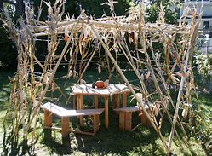
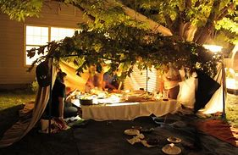
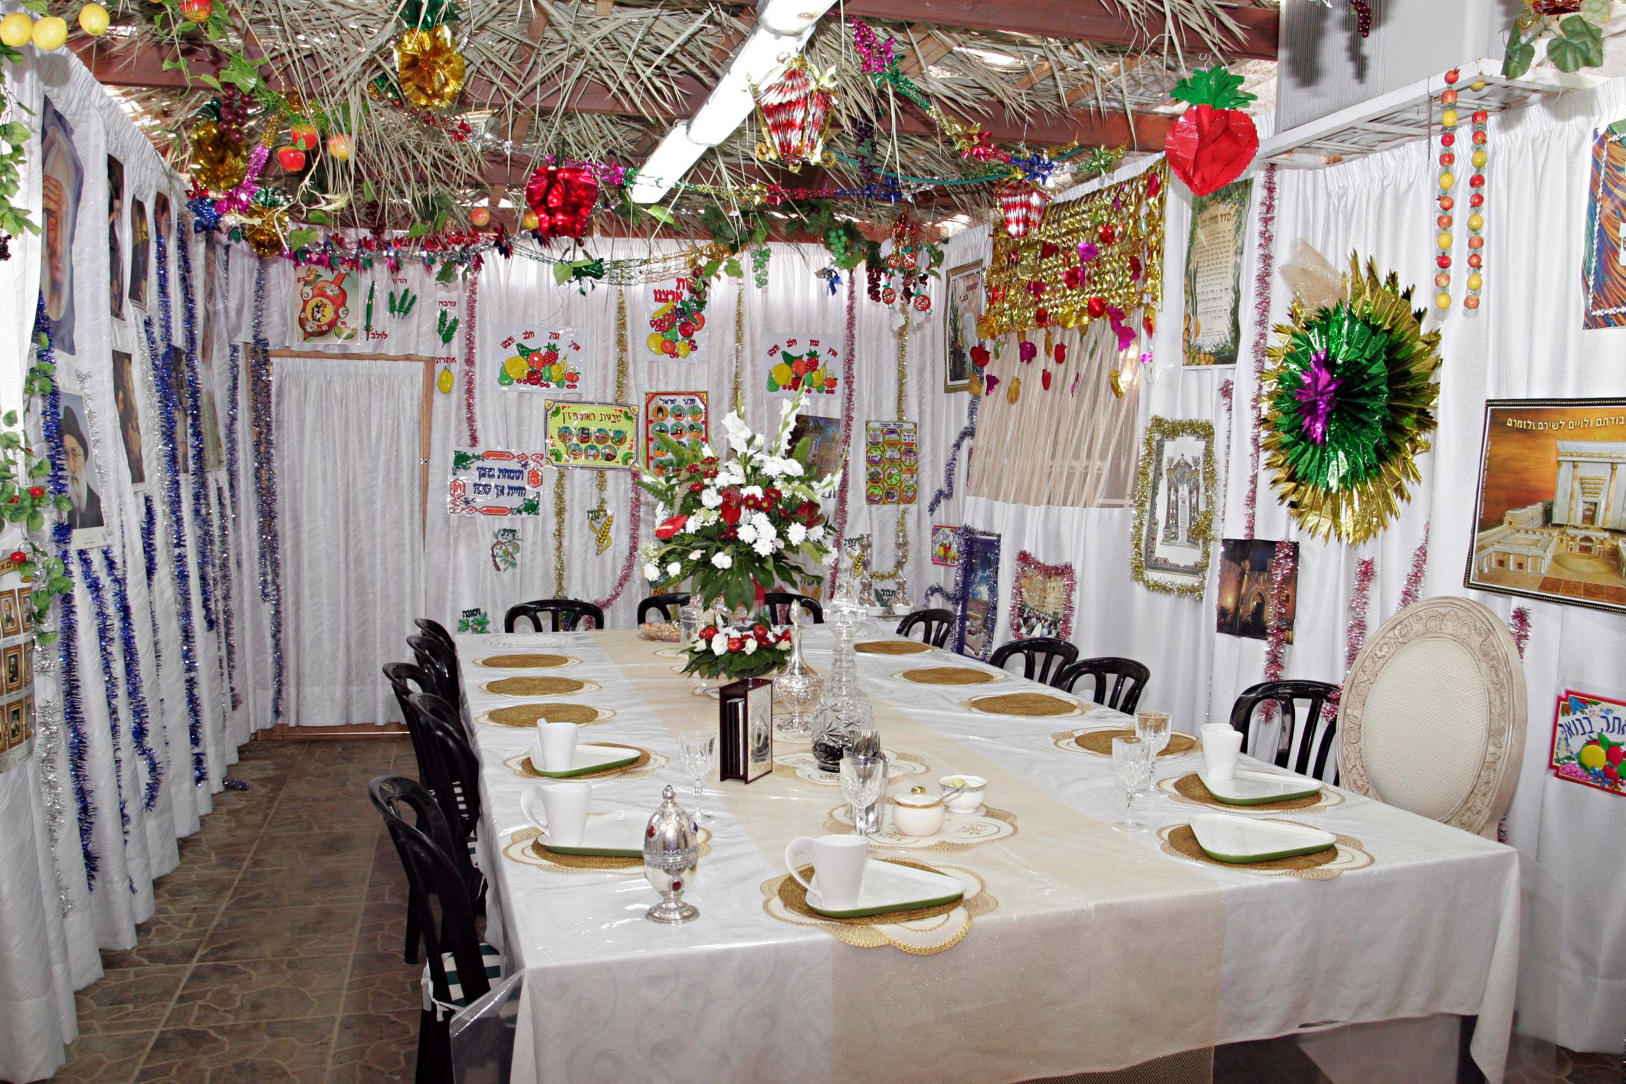
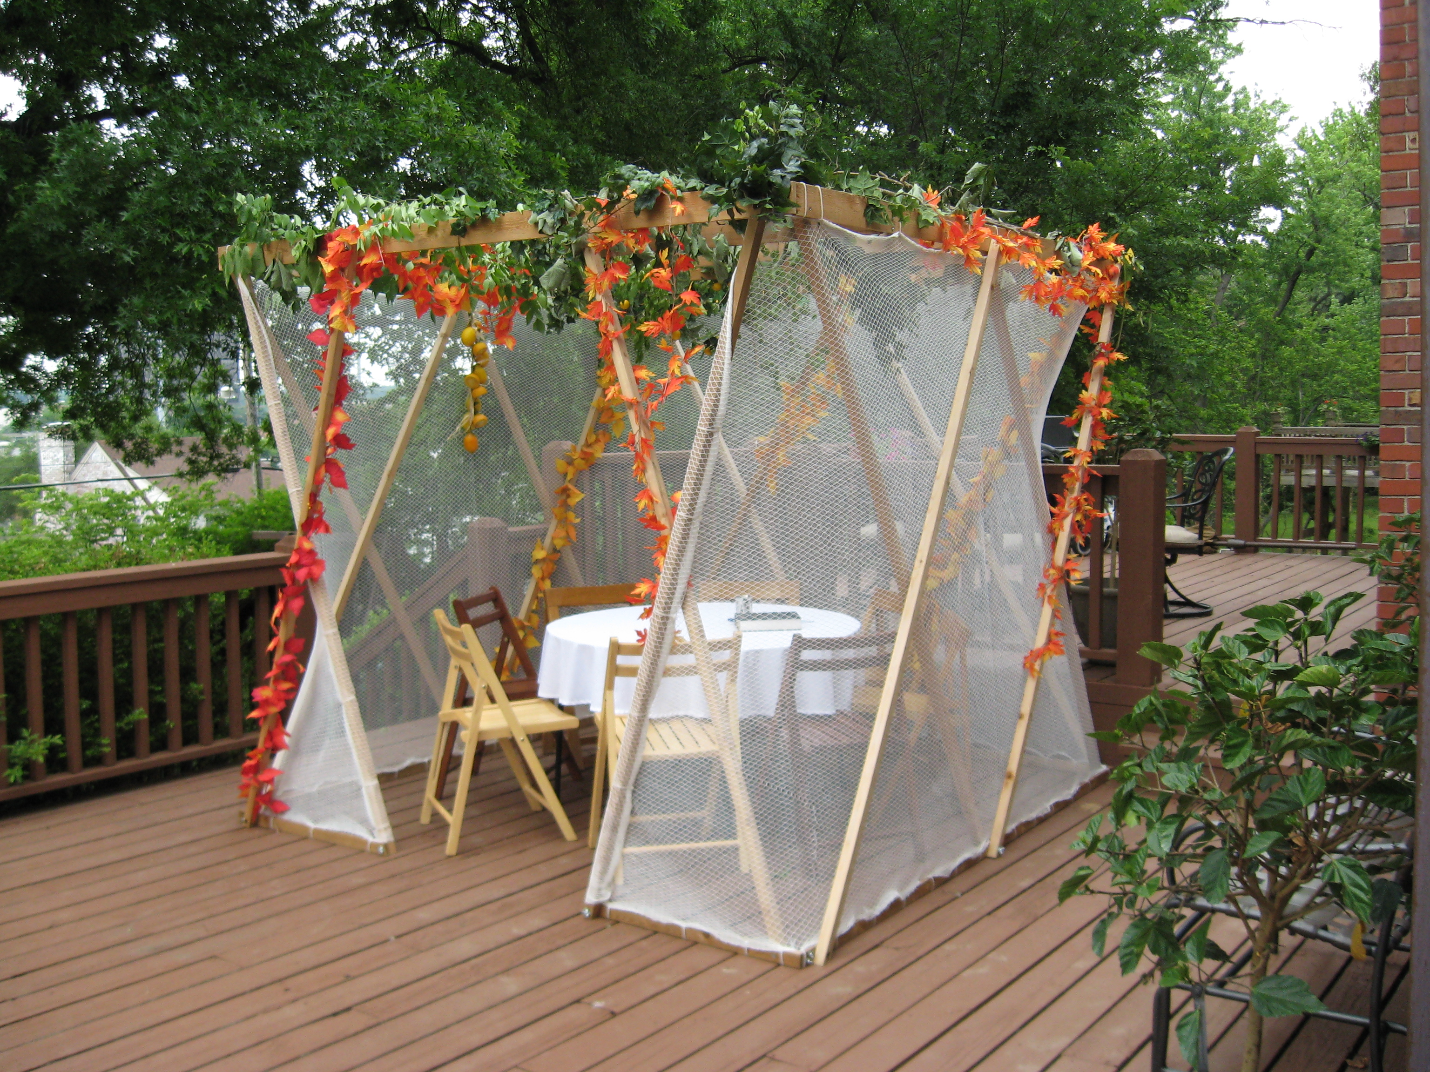
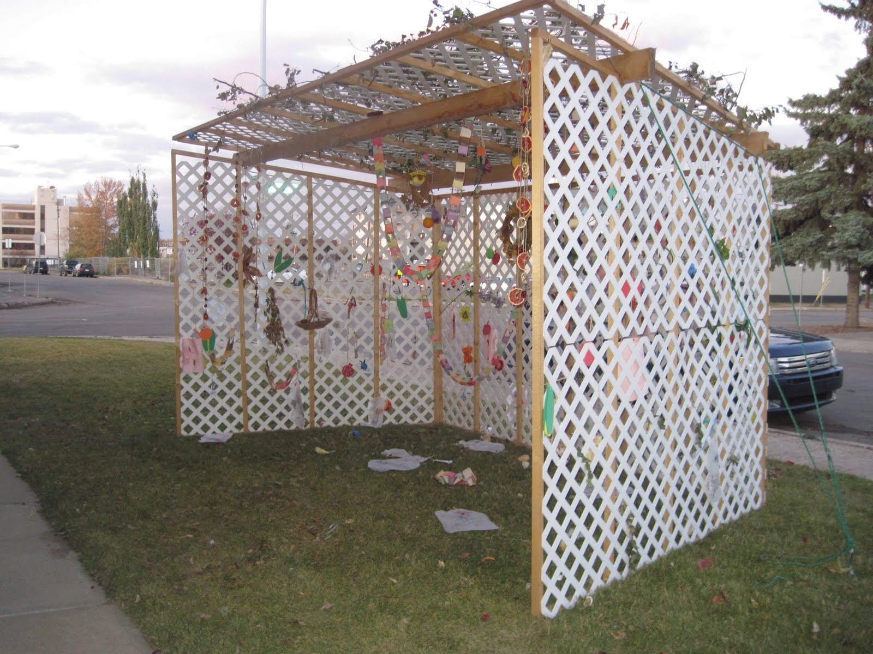
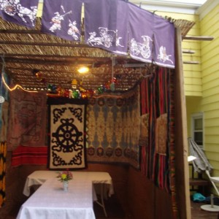
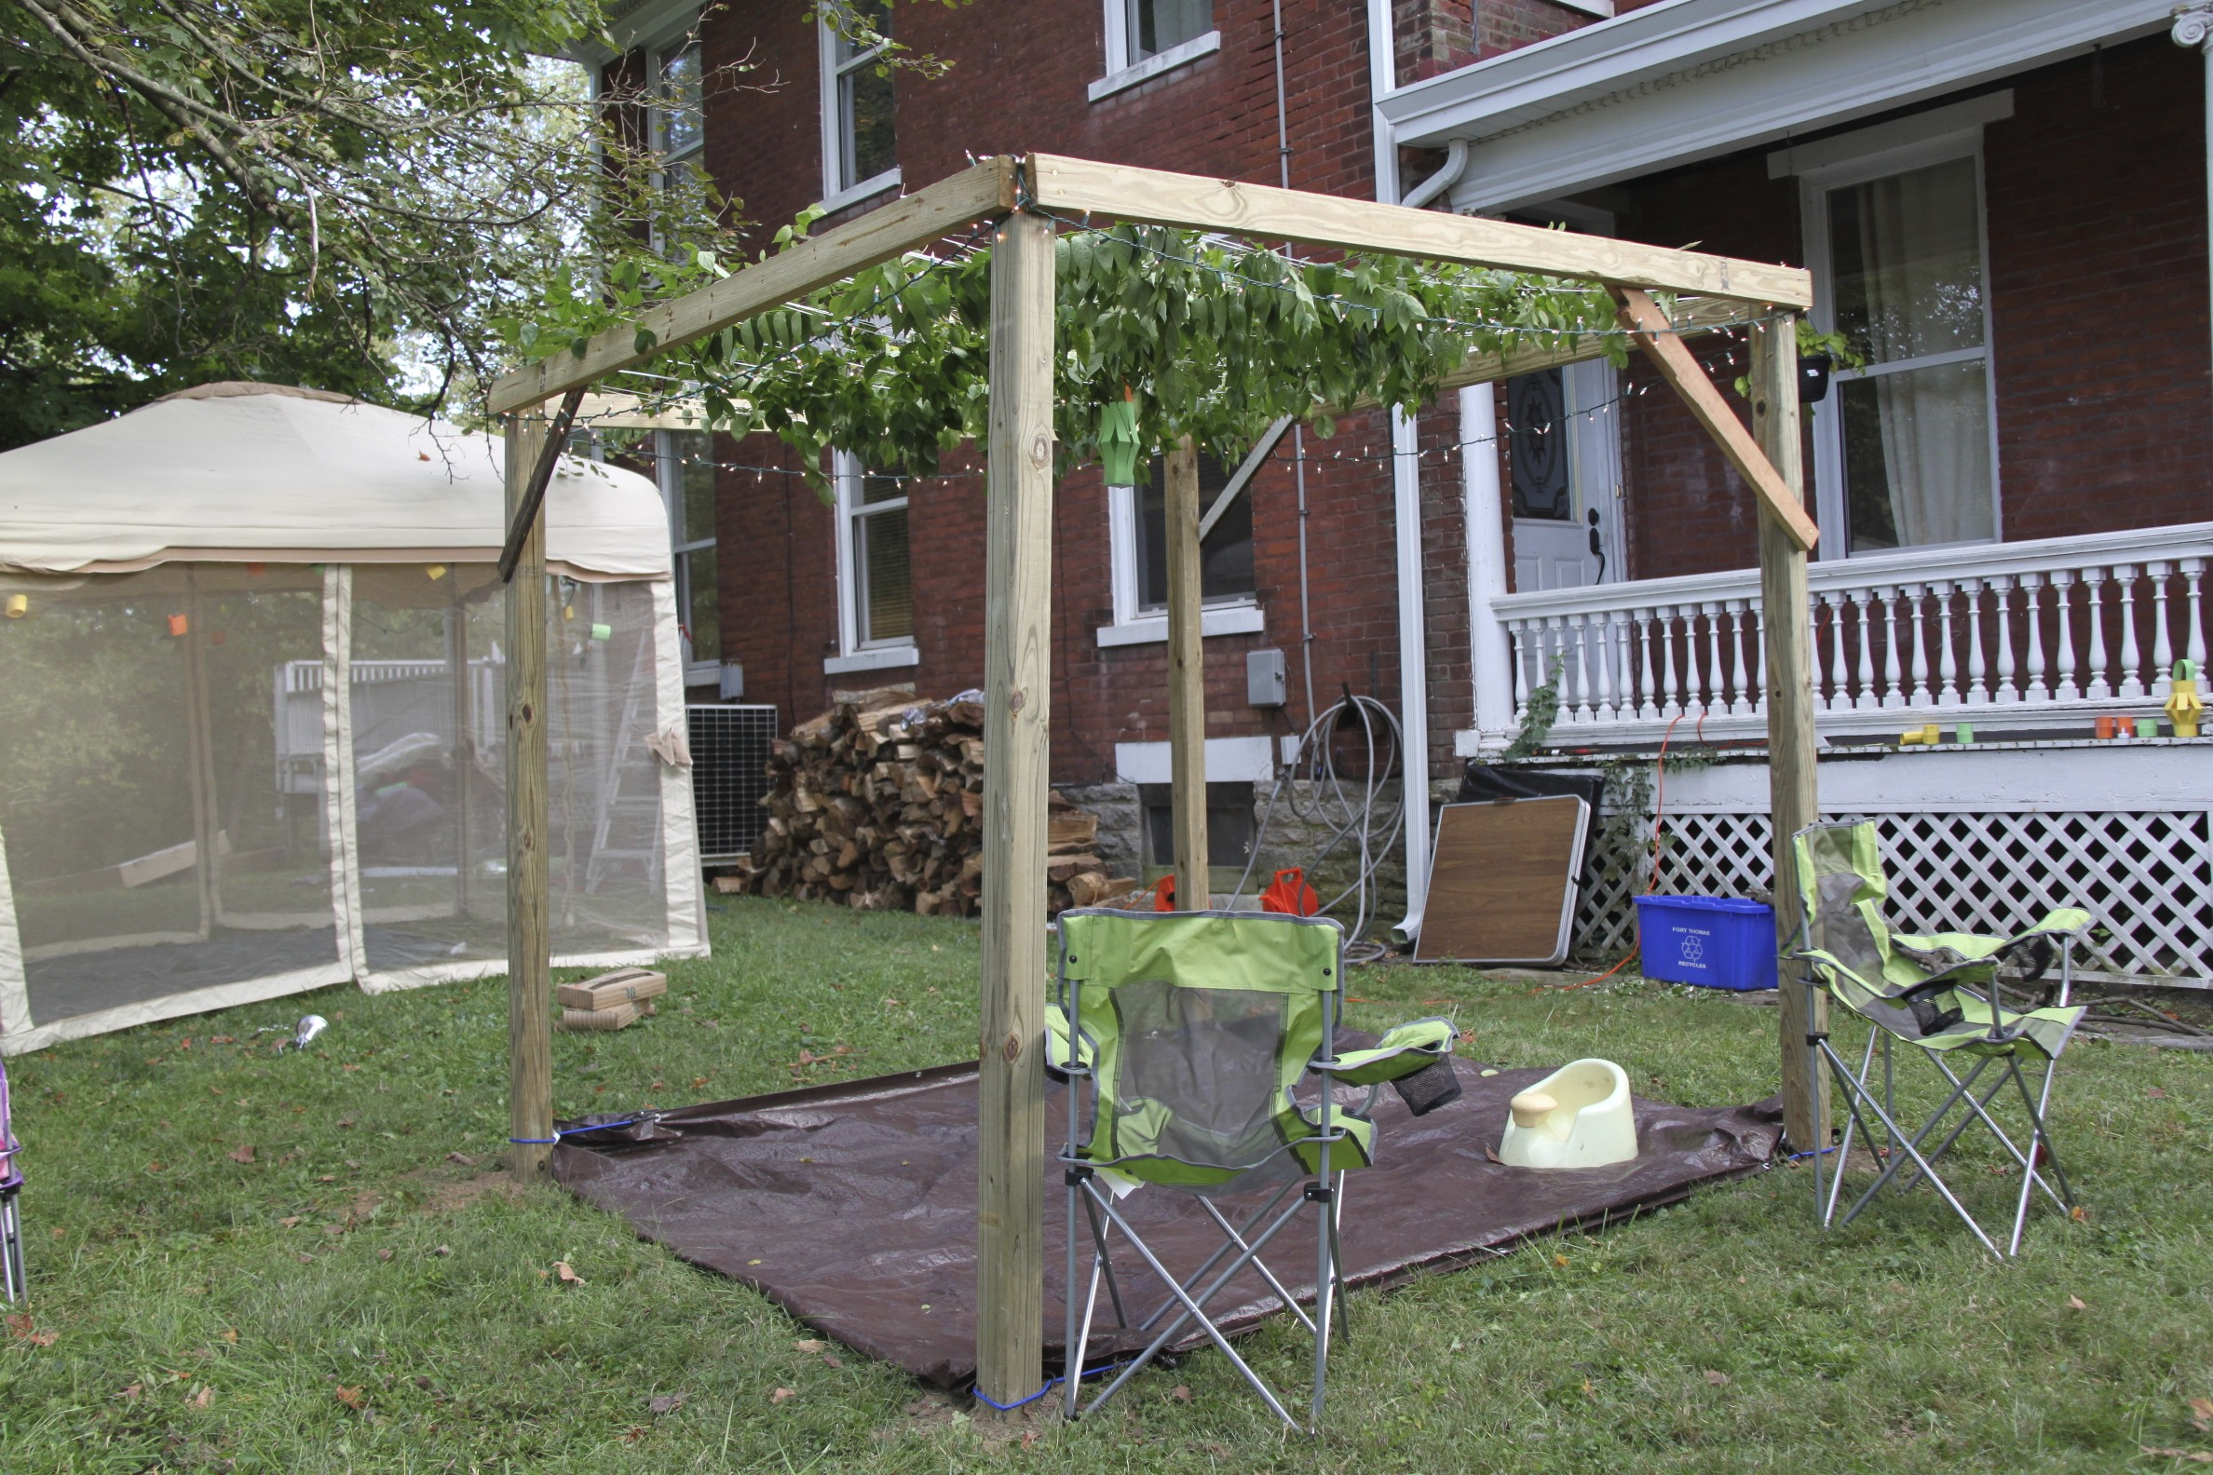
Succot/Tabernacles

Slide 23
Sukkot/Tabernacles—The Last Feast
Names:
Feast of Tabernacles
Beast of Booths
Sukkot
Hebrew: hag succot (pilgrimage feast)

Slide 24
Sukkot/Tabernacles—The Last Feast
Reason for pilgrimage—Make sacrifices in Tabernacle
and later Temple
(Lev 23:36 TLV) For seven days you are to bring an offering by fire to Adonai. The eighth day will be a holy convocation to you, and you are to bring an offering by fire to Adonai. It is a solemn assembly—you should do no laborious work.

Slide 25
Sukkot/Tabernacles—The Last Feast
15th day, 7th month—Begin the Feast
Daily Sacrifices
Could only be made in the Tabernacle/Temple
Most extravagant and expensive of Feasts
182 Sacrifices
Including 70 Bulls*
336 tenths of ephahs of flour for the meal offering

Slide 26
Sukkot/Tabernacles—The Last Feast
70 Bulls as Burnt Offering
*Said to represent the 70 Nations from Noah and sons
14 rams
98 lambs = 182 Total Sacrifices
Just for fun: all categories divisible by 7

Slide 27
Sukkot/Tabernacles—The Last Feast
In Addition to 182 Animal Sacrifices
and the Meal offerings
Introduction of the “Drink Offering”
or Libation Offering
Here is basically a water offering
Connected to agriculture-request for rain

Slide 28
Sukkot/Tabernacles—The Last Feast
Water or libation offering
No real instructions
Over time a series of traditions developed
Overview of water libation in Yeshua’s time
High Priest gathered water from Siloam Pool
Other priests gathered willow branches
placed at Altar of Burnt Offerings

Slide 29
Sukkot/Tabernacles—The Last Feast
Some say the vessel with water passed to the Altar
Some say High Priest carried
High Priest would wait at Water Gate
At the sound of trumpets, goes to Altar
Pour out water while saying:
“Therefore with joy you will draw water from the wells of salvation.” Isa.12:3

Slide 30
Sukkot/Tabernacles—The Last Feast
A priest pours wine at Altar
Now came a time of praise and singing
Psalm 118:25 recited:
“Save now, I pray, O Lord; O Lord, I pray send prosperity”
During music and reciting-Priest marched, waving
Palm Branches (ring a bell?)

Slide 31
Sukkot/Tabernacles—The Last Feast
Brief exposition of John 7
Read John 7
Now the Jewish Feast of Tabernacles was near. (Joh 7:2 TLV)
About 30 A.D.
Fall or near Fall
After these events, Yeshua was walking about in the Galilee. He did not want to walk in Judea, because the Judean leaders wanted to kill Him. (Joh 7:1 TLV)

Slide 32
Sukkot—John 7
We know two things:
Feast of Tabernacles was coming
Jesus knew Judean leaders wanted Him dead
(some translations simply say “Jews” which is wrong)
We need to know the politics
Yeshua lived in Galilee, Judeans around Jerusalem
Galileans didn’t like Judeans, and vice versa
Nobody liked the Samaritans

Slide 33
Sukkot—John 7
Israel is a fractured society
Usually confined to territorial lines
Judea high intellectual, religious based, educated
Galilee more laid back, conservative, not so
educated
To become “educated” had to go to Jerusalem
Joh 7:15 …“How does this man know so much, having never been taught?”

Slide 34
Sukkot—John 7
Samaritans disliked by Galileans and Judeans
Mixed blood at diaspora
Created their own form of Judaism
Own Priests
Sacrifices
Built their own Temple—Mt. Gerazim.

Slide 35
Sukkot—John 7
About halfway through the Feast, Yeshua went up to the Temple and began teaching. (Joh 7:14 TLV)
During the Feast, Yeshua began teaching
And this created a situation
Then the Judean leaders were amazed, saying, “How does this man know so much, having never been taught?” (Joh 7:15 TLV)
Only Rabbinical schools in Jerusalem
Galileans wouldn’t go there if they would have them!!
Yeshua clearly identifies Himself in v. 28
“You know where I am from”

Slide 36
Sukkot—John 7
Last day of the last feast
Called: Hoshana Rabbah
Events of day expanded and theatrical
High Priest entered Water Gate, Golden jar in hand
Levites blew trumpets 7 times
Crowd becomes quiet and waits

Slide 37
Sukkot—John 7
High Priest approaches Altar
Creating drama and focus, lifts the golden pitcher
People anticipate the last event of the feast…
HP Slowly pours out water in total silence
Yeshua cries out at this moment
Joh 7:37-38 TLV On the last and greatest day of the Feast, Yeshua stood up and cried out loudly, “If anyone is thirsty, let him come to Me and drink. (38) Whoever believes in Me, as the Scripture says, ‘out of his innermost being will flow rivers of living water.’”

Slide 38
Sukkot—John 7
IMAGINE….against the silence, He cries out
Offended the priests, Pharisees, Judeans…Just about everyone!
This single act, seals the fate of our Messiah

Slide 39
Sukkot—Back to Leviticus
Additional command: Live in Succahs
Today, meals maybe, not total live in
Recognition of the intent of the feast

Slide 40
Fall Feasts-Summary
Passover Egypt Release Messiah Crucifixion
Unleavened Bread Israel begins trip Yeshua Buried
Firstfruits New Harvest Yeshua Resurrected
(into Kingdom)
Pentecost Summer Harvest Gathers man into Kingdom
Trumpets New Year Call to Assemble God’s People
Day of Atonement Clean Temple Cleansing Us as Temples
Tabernacles Dwelling Millennial Kingdom

Slide 41
Zec 14:16-20 TLV Then all the survivors from all the nations that attacked Jerusalem will go up from year to year to worship the King, Adonai-Tzva’ot, and to celebrate Sukkot. (17) Furthermore, if any of the nations on earth do not go up to Jerusalem to worship the King, Adonai-Tzva’ot, they will have no rain. (18) If the Egyptians do not go up and celebrate, they will have no rain. Instead, there will be the plague that Adonai will inflict on the nations that do not go up to celebrate Sukkot. (19) This will be the punishment of Egypt and the punishment of all the nations that do not go up to celebrate Sukkot. (20) In that day “Holy to Adonai” will be inscribed on the bells of the horses and the pots in House of Adonai will be like the sacred bowls in front of the altar.

